Slide 1
CET300 Project
Week 2
Dr Siobhan Devlin

Slide 2
ePortfolio
It will be used extensively in this module - with structure and purpose to it:
  for supervision,
  for client contact (secret URL)
  For final presentation
Gary will be running a surgery at 1pm today for anyone who has yet to get their eportfolio established ready for next supervision session
Template is in Sunspace
Every supervision session requires a new entry from you in your supervision record tab

Slide 3
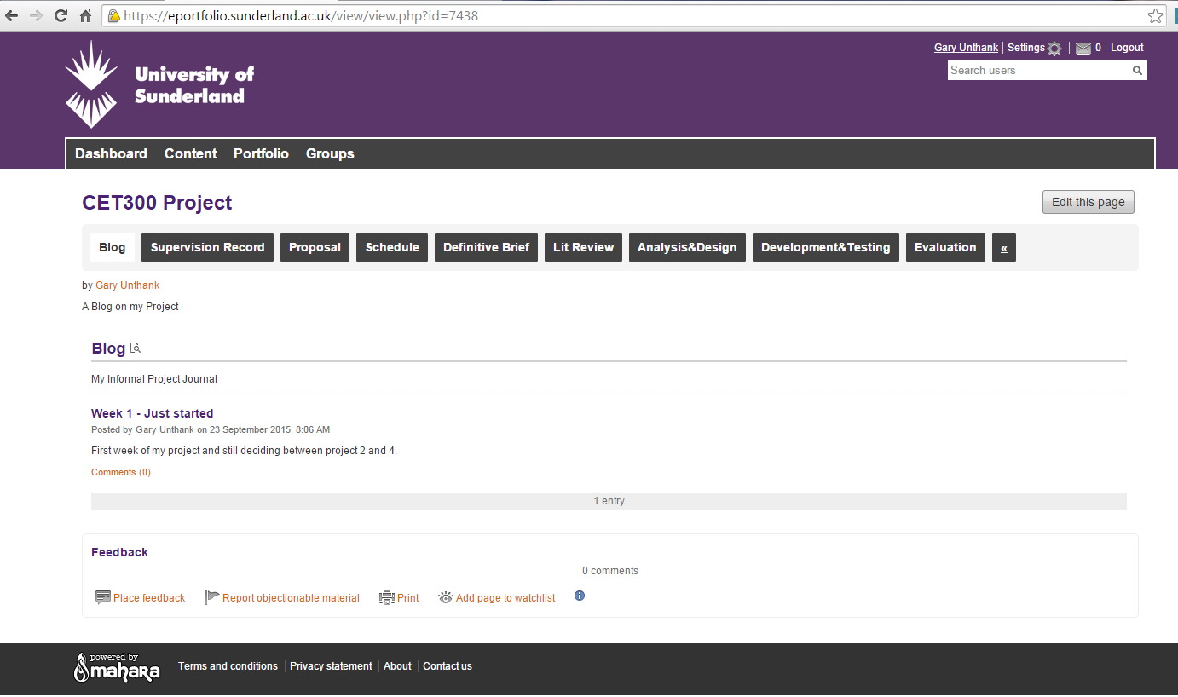

Slide 4
Supervision and tutorials from today
Timetable for supervisions in Sunspace now
If you are a week B student you have supervision this week
If you are a week A student you have supervision next week
I am available today for ‘surgery’ advice with week A students because tutorials won’t begin properly until next week – Project room DG218
Gary’s students – back to normal: 2pm-4pm

Slide 5
What should you be doing now?
Finding out about which project you can do – but don’t sit and wait
  There is plenty you can be doing
  Schedule
  Customising the proposal
  PACT – template in Sunspace
  Uploading proposal to your eportfolio
  Printing it out and putting it in the box in DG218
  Starting to find literature to read
    Sessions can start this Friday if you want? Sign up sheet

Slide 6
Initial Proposals
Your Initial Proposal Document must be signed off (approved) no later than week 2.
  1st October
Allocation will be complete in next day or 2
By week 5 you must submit a draft Definitive Brief.
  You will peer review them then resubmit in week 6 for formal marking

Slide 7
Initial Proposal
Once an idea for a project has been established, your first task will be to draft an initial proposal document which incorporates the main aims and objectives of the project.
Download from sunspace
Think about it – talk over ideas with supervisor
Supervisors will offer advice and guidance to ensure that the project is achievable within the scope of the module and also, that the objectives are of a suitable standard for an Honours Degree.

Slide 8
Finalising the proposal
Often they have way too much detail on them
  Keep some detail for your Definitive Brief
More often they are still too brief
  E.g. still don’t contain what I’ve asked for!
Reminder
Insert rows at the top for your name and programme and agreed project title
Remove words like ‘suggested’ from the original proposal
‘Project Description’ should be the largest box and describe what the context of the problem is/who the client is and what you plan to do – broken down into bullet points (all stages of project life cycle)
‘Specific requirements’ – resources, programming languages, people, etc. you’ll need to complete the project
‘Practical Outcome’ – needs to be a long section with detailed bullet points of your system functionality.

Slide 9
Finalising the proposal
‘Research Focus’ – narrow down to no more than 2 possible topics.
‘Reading’ – give any references of papers and texts you’ve consulted so far – should be 5
‘Additional Info’ – should no longer contain information such as whether there’s scope for more than one project. Rename it ‘Constraints’ and state what might hinder you from completing the project successfully.
‘Ethical Issues’ – state clearly whether or not you are working with children or vulnerable adults; whether there are any social, ethical, professional or legal issues needing to be considered. Data Protection? Security issues? Do not put n/a in this box.
‘Sponsor details & signature’
‘Module leader signature’
END OF WEEK 2 PLEASE!

Slide 10
Project Title: | Actual agreed title here
Academic Area: | Should conform to your Programme
Project Description: | Fairly in depth description followed by a break down of likely activities: Research Requirements analysis Design, development and testing Evaluation Write up
Specific Requirements: | Resources etc.; specifications from the client
Practical Outcome:
Research Focus: | Try to narrow this down to one
Reading: | Some useful references – 5 or 6 (Primarily NOT text books or websites)
Additional Info: | Possible Constraints

Slide 11
Scoping & Scheduling

Slide 12
Schedule
template is in Sunspace
It give an indication of how to do it, what to include – but there are missing elements! Do not copy it exactly!
It should make you think about your own project.

Slide 13
Breaking down the tasks
It is your responsibility to scope and specify the project. You must
  have a concrete element of academic research
  have a single topic/aim/hypothesis
  have a substantial practical element which you must
    Analyse (requirements of),
    Design
    Develop
    Test
    Evaluate
  You must critically evaluate both the research & the practical element

Slide 14
Feasibility of the Project
Check that
  the project is achievable in the timescale
  You have access to the data
  You have access to client
  You have access to the necessary software/hardware
  You are able to evaluate it properly
  You are able to adhere to any necessary standards
  Anything else???

Slide 15
Stages in the Project
Planning & Control Stages
Documentation
Literature Review (theory and write up)
Practical elements
  Requirements analysis
  Design, development and testing
  System Evaluation
Project Evaluation
Write up
Presentation and Viva

Slide 16
Activities in the Project
???

Slide 17
Activities in the Project
Weekly contact sessions (reporting)
  lecture/workshop/tutorials plus supervision
Keeping a weekly learning log
  How long to spend on this?
Reading
Writing (as an ongoing activity)
Learning the programming language/ software development environment
Analysing, Designing, Developing, Testing
Evaluation – of research, of developed product, of how research informed development, of self.

Slide 18
The Client/Sponsor
???

Slide 19
The Client/Sponsor
How will you interact with them?
  Face to face; email; phone; Skype; etc…
  Informal; formal interview – consider time.
Why will you interact with them?
  What do you need from them?
  Input into Analysis, Design, Development, Testing & evaluation
How often?
  Start and end of project? In between? Weekly; Monthly; Quarterly? Regular for prototyping approach…

Slide 20
The Client/Sponsor
When will you meet/confer?
Where?
  Consider travel also.
How long will it take each time?
How will the interactions be documented?
  Paper/audio/video? When will you write it up?

Slide 21
Project Timetable
24 weeks total
Keep regular hours each week
Total of 400 hours to utilise
  Your schedule should add up to this!
  40ish hours contact time, so 360 self study
  That’s 16 hours per week on your own!

Slide 22
Breaking down tasks (1)
Planning/control
  What does this involve?
  How many hours should I allot to it?

Slide 23
Breaking down tasks (2)
Literature review
  What does it involve?

Slide 24
Breaking down tasks (2)
Literature review
  What does it involve?
    Going to the library/Consulting online services/Searching the web for academic literature
    Getting hold of these materials (Books/journal articles/academic papers/Govt white papers etc)
    Organising them – skim reading and making a relevance judgement
    Reading them properly
    Understanding them
    Making notes
    Drafting a chapter/having it checked/refining a chapter
  BUT, you can only set tasks on your schedule that have concrete deliverables: not all above activities have deliverables!
  How many hours should I allot to the literature review?

Slide 25
Breaking down tasks (3)
Analysis of problem/current situation
  What does this involve?
  How many hours should I allot to it?
  How do you do analysis?
  How and what do you document?
  Who do you involve?

Slide 26
Breaking down tasks (4)
Design of solution/new situation
  What does this involve?
  How many hours should I allot to it?
  How do you design?
  How do you document the design?
  Who do you involve?

Slide 27
Breaking down tasks (5)
Development of solution/artefact
  What does this involve?
  How many hours should I allot to it?
    You MUST break down design/development tasks into small, meaningful subtasks – relating to subcomponents of your system, for example.
      Interface, tables, queries, reports etc…
      Flash Banner, colour scheme, navigation, CSS, each of 10 web pages…
    Only by doing this do you get a picture of how big/small/manageable the planned development is.
  How to document the development process?
  When does it start? Now? After the 1st hand in? After the 2nd?

Slide 28
Breaking down tasks (6)
Testing of solution/artefact
  What does this involve?
    When is it done?
    How often?
    How much?
    What type?
    Who does it?
  How many hours should I allot to it?

Slide 29
Breaking down tasks (7)
Evaluation (of what?)
  What does this involve?
  When is it done?
  How often is it done?
  How many hours should I allot to it?
  Who is involved in evaluation?
  How do I plan around their time?

Slide 30
Breaking down tasks (8)
Write up
  What does this involve?
    When is it done?
    Does it have any hand in dates?
    Who is involved – e.g. for feedback comments?
      Therefore when are they going to be able to read it?

Slide 31
Breaking down tasks (8)
Preparation for presentation and viva
  What does this involve?
  How many hours should I allot to it?

Slide 32
Schedule
No. | Task | Hours | Planned Start | Actual Start | Planned Finish | Actual Finish | Deliverable
 | Planning
1
 | Literature Review
4
 | Developmt

Slide 33
How to do the schedule?
Remember it’s a forward looking thing
  the learning logs will be your ‘backward looking thing’
So – it’s your best estimate at this point
It’s a living tool – so it’s not about being 100% accurate, it’s about working on it continually – expect things to change!
It needs contingency planning (extra time in reserve)
All ‘planned’ dates should be filled in at start
Actual dates get filled in only when they happen!
Deliverables must be tangible!

Slide 34
Schedule
A complete schedule must be submitted in the Definitive Brief
A complete Gantt Chart must be submitted in the Definitive Brief
See the handout on both in Sunspace
Don’t do the Gantt Chart until your schedule has been approved by your supervisor – get it approved before the Definitive Brief hand in

Slide 35
Look for Project Management tools
Ones that you can work well with
E.g. TRELLO
  Can fit in well with eportfolio

